Slide 1
Recognizing Object Instances
Slides adapted from Kristen Grauman, Lana Lazebnik, and Ondrej Chum

Slide 2

Today: instance recognition
Motivation: Visual search
Last Class: Visual words
quantization, index, bags of words
Today: Spatial verification
affine; RANSAC, Hough
Google Image Search for this picture

Slide 3

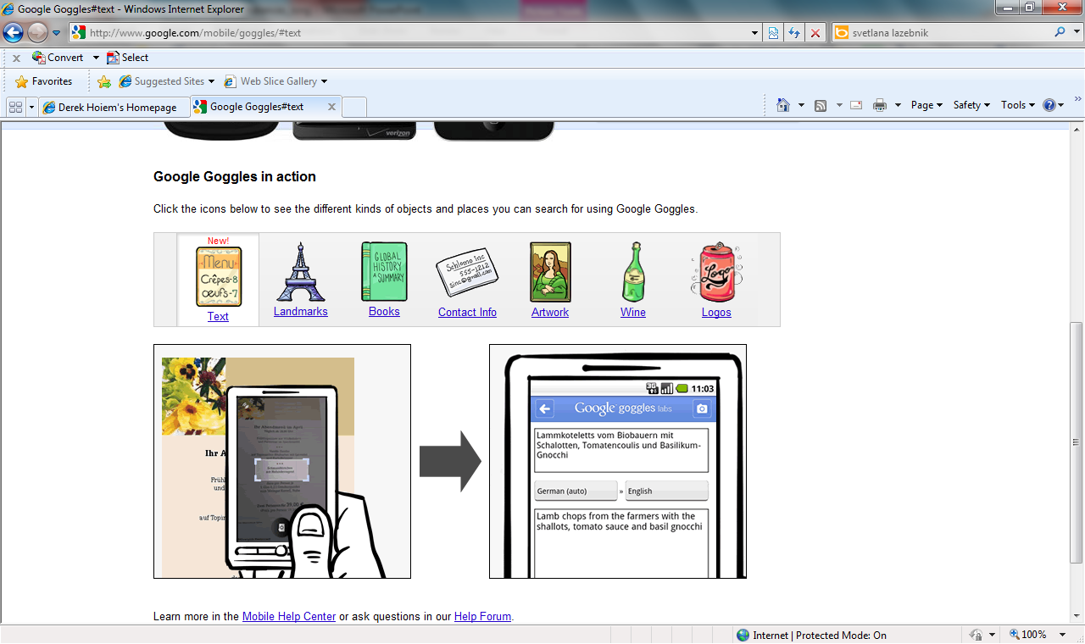
Notes:
http://www.google.com/mobile/goggles

Slide 4
Recap: Indexing Local Features
Each patch / region has a descriptor, which is a point in some high-dimensional feature space (e.g., SIFT)
Descriptor’s feature space
Notes:
4

Slide 5
Recap: Indexing Local Features
When we see close points in feature space, we have similar descriptors, which indicates similar local content.
Query image
Descriptor’s feature space
Database images
Easily can have millions of features to search!

Slide 6
Recap: Vector Quantization
Map high-dimensional descriptors to tokens/words by quantizing the feature space
Based on clustering (e.g., k-means)
Quantize via clustering, let cluster centers be the prototype “words”
Word #2
Determine which word to assign to each new image region by finding the closest cluster center
Descriptor’s feature space

Slide 7
Recap: Visual Vocabulary Issues
Vocabulary size, number of words
Sampling strategy: where to extract features?
Clustering / quantization algorithm
Unsupervised vs. supervised
What corpus provides features (universal vocabulary?)

Slide 8

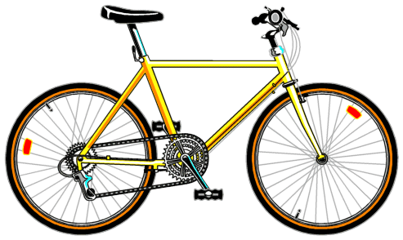
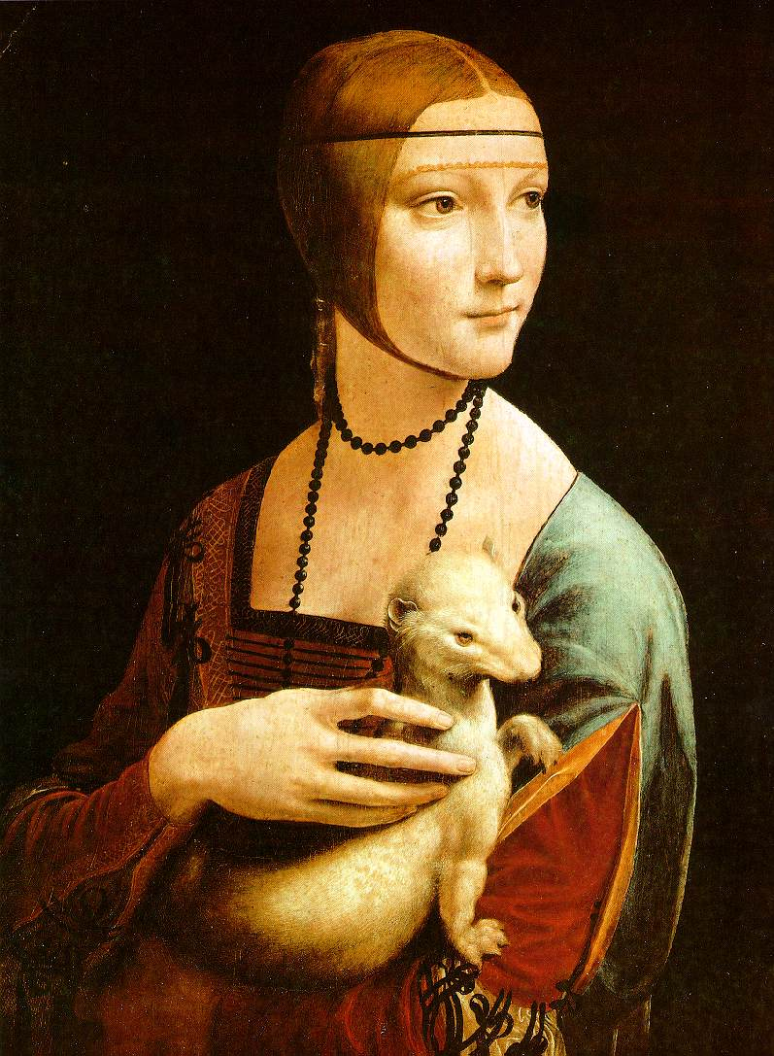
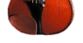

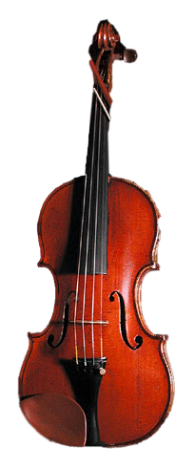
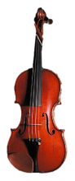

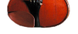

Recap: Bags of Visual Words
Summarize entire image based on its distribution (histogram) of word occurrences.
Analogous to bag of words representation commonly used for documents.
Notes:
8

Slide 9
Recap: Bags of (visual) Words
+ flexible to geometry / deformations / viewpoint
+ compact summary of image content
+ provides vector representation for sets
+ very good results in practice
background and foreground mixed when bag covers whole image
optimal vocabulary formation remains unclear
basic model ignores geometry – must verify afterwards, or encode via features
Is having the same set of visual words enough to identify the object/scene?
Notes:
9

Slide 10
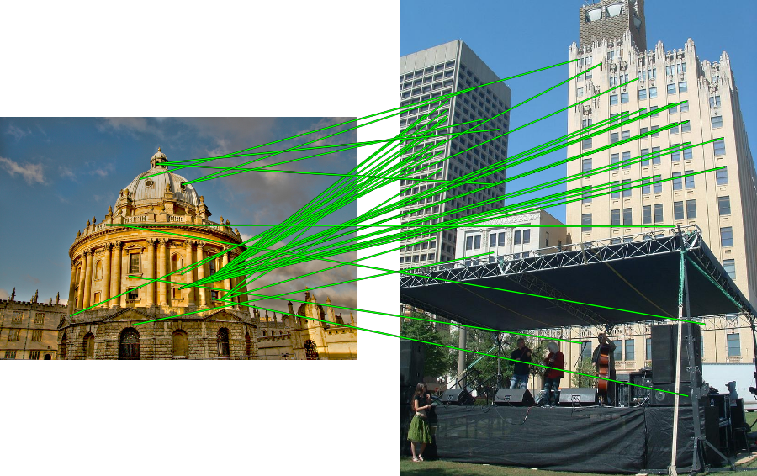
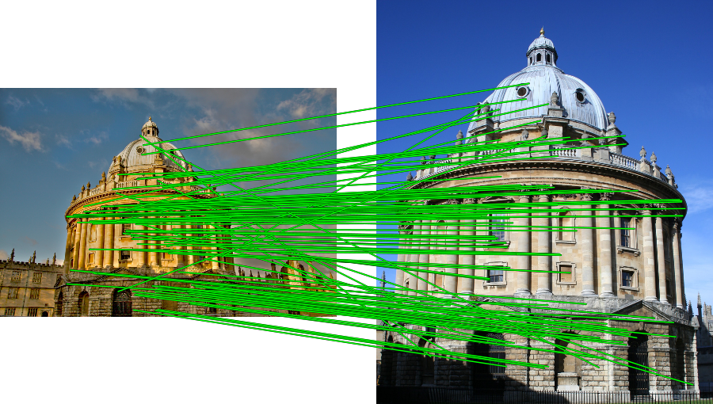
Spatial Verification
Query
Query
DB image with high BoW similarity
DB image with high BoW similarity
Both image pairs have many visual words in common.

Slide 11
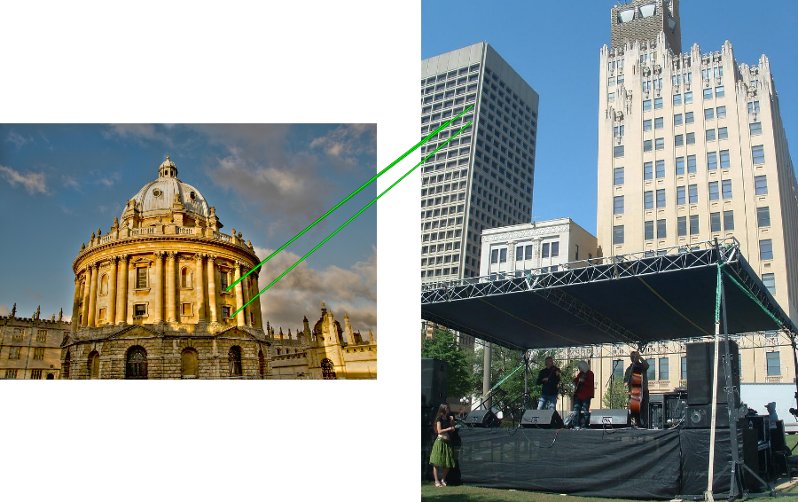
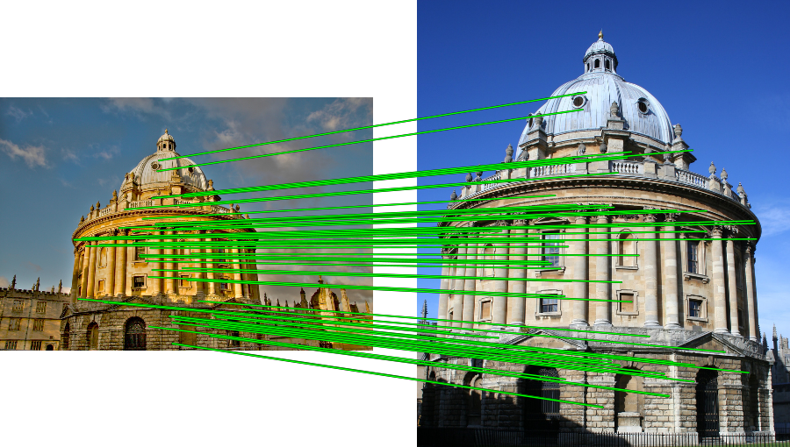
Spatial Verification
Query
Query
DB image with high BoW similarity
DB image with high BoW similarity
Only some of the matches are mutually consistent

Slide 12
Spatial Verification: Generalized Hough Transform
Generalized Hough Transform
Let each matched feature cast a vote on location, scale, orientation of the model object
Verify parameters with enough votes
Let’s quickly review Hough Transform…
Kristen Grauman

Slide 13
Line Detection: Hough Transform
Let each feature vote for all the models that are compatible with it
Hopefully the noise features will not vote consistently for any single model
Missing data doesn’t matter as long as there are enough features remaining to agree on a good model

Slide 14
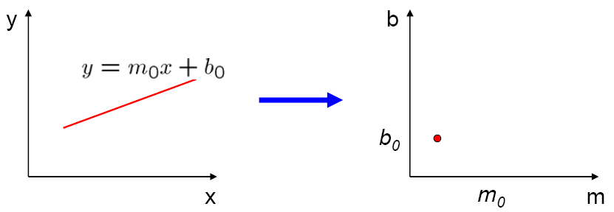
Parameter space representation
A line in the image corresponds to a point in Hough space
Image space
Hough parameter space

Slide 15
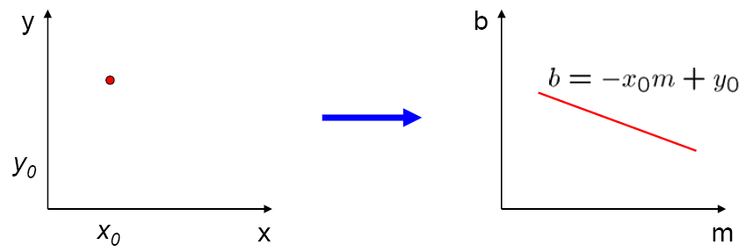
Parameter space representation
A point (x₀, y₀) in the image space maps to a line in the Hough space
Specifically: the solutions of b = –x₀m + y₀
Image space
Hough parameter space

Slide 16
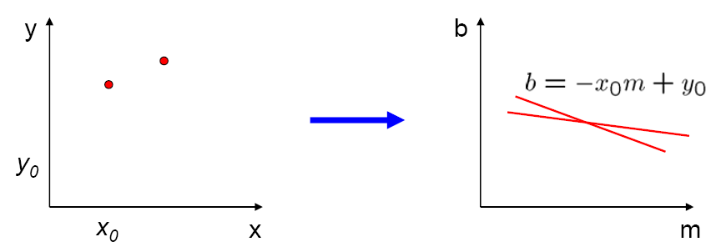
Parameter space representation
Where is the line that contains both (x₀, y₀) and (x₁, y₁)?
It is the intersection of the lines b = –x₀m + y₀ and b = –x₁m + y₁
Image space
Hough parameter space
(x₁, y₁)
(x₀, y₀)
b = –x₁m + y₁

Slide 17
Basic Hough Transform
Points which lie on the same line in image space will have lines which intersect at a point in Hough space
So, to find image line(s), we find the point(s) in Hough space where multiple Hough lines intersect.
If the points don’t lie exactly on the same line in image space, the lines in Hough space won’t intersect
We can count intersections if they are “close” using by discretizing Hough space
Hough Space
3 lines pass through this grid cell
Hough Accumulator

Slide 18
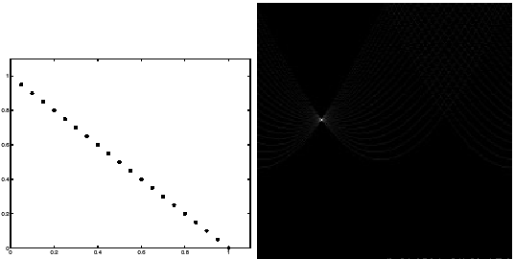
Basic illustration
features
votes
Notes:
Figure 15.1, top half. Note that most points in the vote array are very dark, because they
get only one vote.

Slide 19
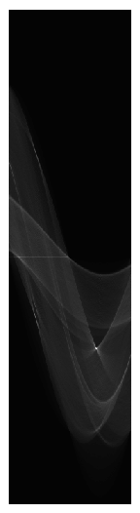
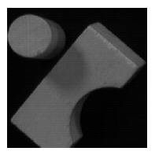
Several lines

Slide 20
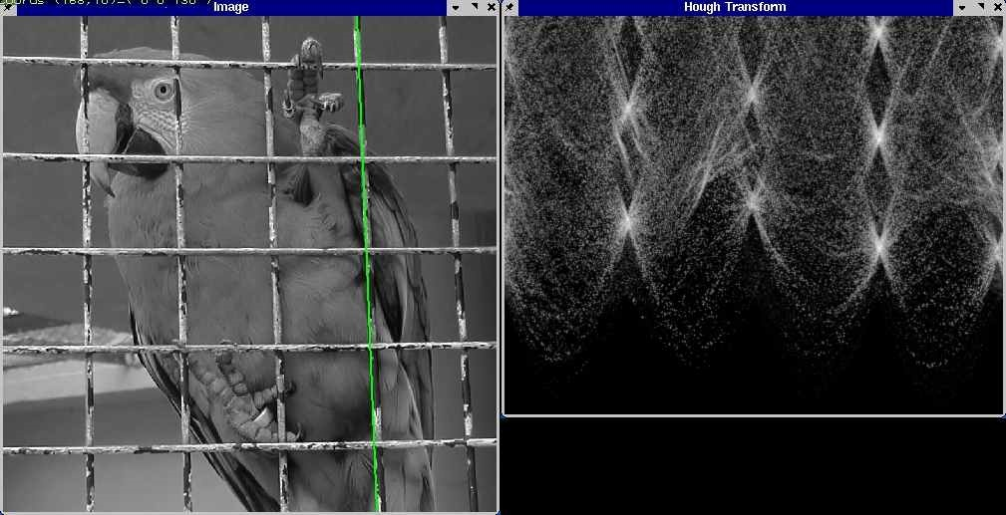
Real Image
http://ostatic.com/files/images/ss_hough.jpg

Slide 21
Hough Transform
Not just for lines
Can be applied to any parametric model
Hough Transform for Circles
How many dimensions will the parameter space have?
Given an oriented edge point, what are all possible bins that it can vote for?

Slide 22
Hough transform for circles
image space
Hough parameter space
r
y
(x,y)
x
x
y

Slide 23
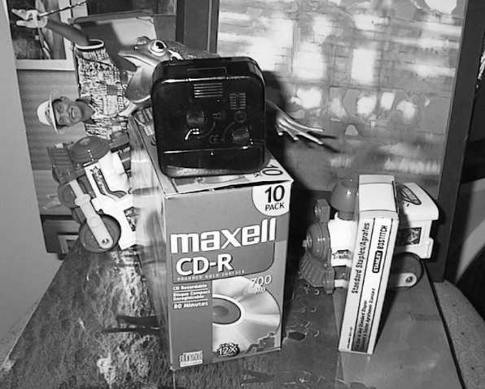
Voting: Generalized Hough Transform
If we use scale, rotation, and translation invariant local features, then each feature match gives an alignment hypothesis (for scale, translation, and orientation of model in image).
Model
Novel image

Slide 24
Voting: Generalized Hough Transform
A hypothesis generated by a single match may be unreliable,
So let each match vote for a hypothesis in Hough space
Model
Novel image

Slide 25
Gen Hough Transform details (Lowe’s system)
Training phase: For each model feature, record 2D location, scale, and orientation of model (relative to normalized feature frame)
Test phase: Let each match btwn a test SIFT feature and a model feature vote in a 4D Hough space
Use broad bin sizes of 30 degrees for orientation, a factor of 2 for scale, and 0.25 times image size for location
Vote for two closest bins in each dimension
Find all bins with at least three votes and perform geometric verification
Estimate least squares affine transformation
Search for additional features that agree with the alignment
David G. Lowe. "Distinctive image features from scale-invariant keypoints.” IJCV 60 (2), pp. 91-110, 2004.

Slide 26
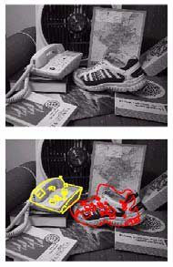
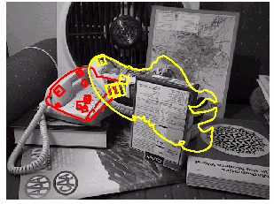
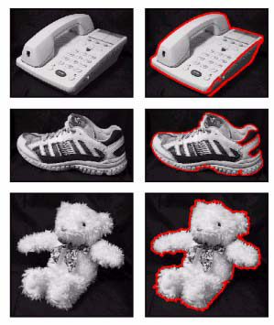
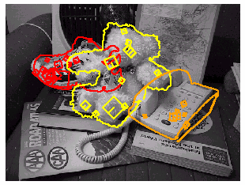
Example result
Background subtract for model boundaries
Objects recognized,
Recognition in spite of occlusion
[Lowe]

Slide 27
Difficulties of Hough Voting
Noise/clutter can lead to as many votes as true target
Bin size for the accumulator array must be chosen carefully
In practice, good idea to make broad bins and spread votes to nearby bins, since verification stage can prune bad vote peaks.

Slide 28
Recognition via alignment
Pros:
Effective when we are able to find reliable features within clutter
Great results for matching specific instances
Cons:
Scaling with number of models
Spatial verification as post-processing – not seamless, expensive for large-scale problems
Not suited for category recognition.

Slide 29
Summary
Matching local invariant features
Useful not only to provide matches for multi-view geometry, but also to find objects and scenes.
Bag of words representation: quantize feature space to make discrete set of visual words
Summarize image by distribution of words
Index individual words
Inverted index: pre-compute index to enable faster search at query time
Recognition of instances via alignment: matching local features followed by spatial verification
Robust fitting : RANSAC, GHT

